Slide 1

Whole-of-government Approach to Establish CRVS in Bangladesh
Md. Ashfaqul Amin Mukut
Deputy Secretary
CRVS Secretariat
&
Deputy Project Director, GoB-D4H CRVS Project
Cabinet Division
Workshop for selected National CRVS Focal Points
12-14 December 2017

Slide 2
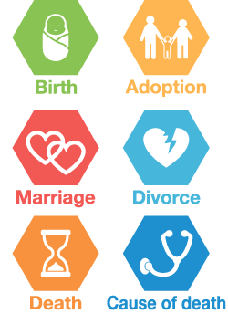






Civil Registration
DPE, DSHE, Univ.
IGR
DPI
Enrolment
Migration
ORG
ECB
Voter
DGHS
Notes:
Two outcome documents from the Ministerial Conference:
A Ministerial Declaration to ‘Get Every One In The Picture’
A Regional Action Framework for the Decade, which contains 3 goals that you can see on the bottom right
Universal civil registration (blue icon)
All individuals are provided with legal documents to claim identity and ensuing rights (red icon)
Accurate, complete and timely vital statistics (green icon)
The Regional Action Framework have 7 areas of action, and under each of the goals a framework of targets that each country would set individually, for example by 2024, 99% of births shall be registered and 80% of deaths shall be registered.

Slide 3
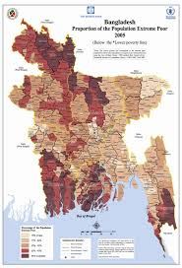
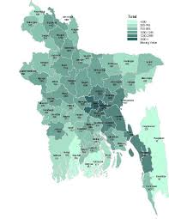
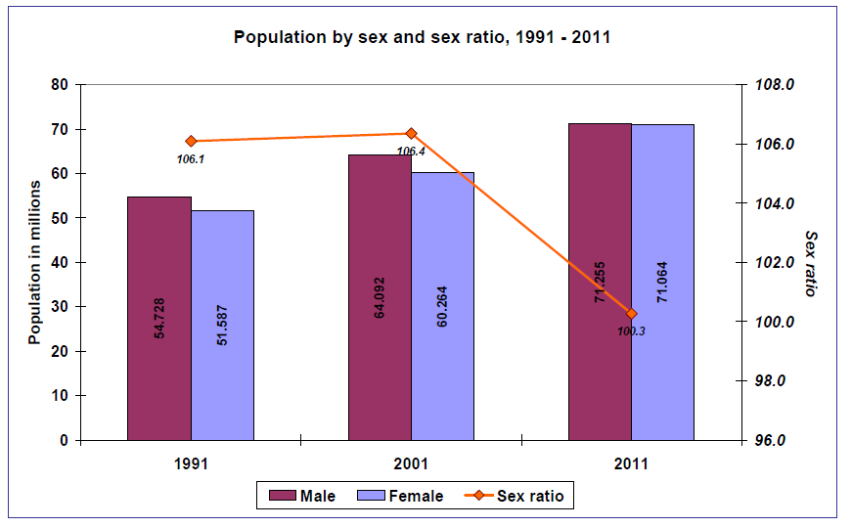
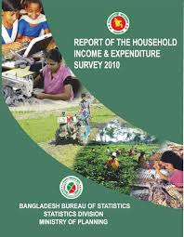
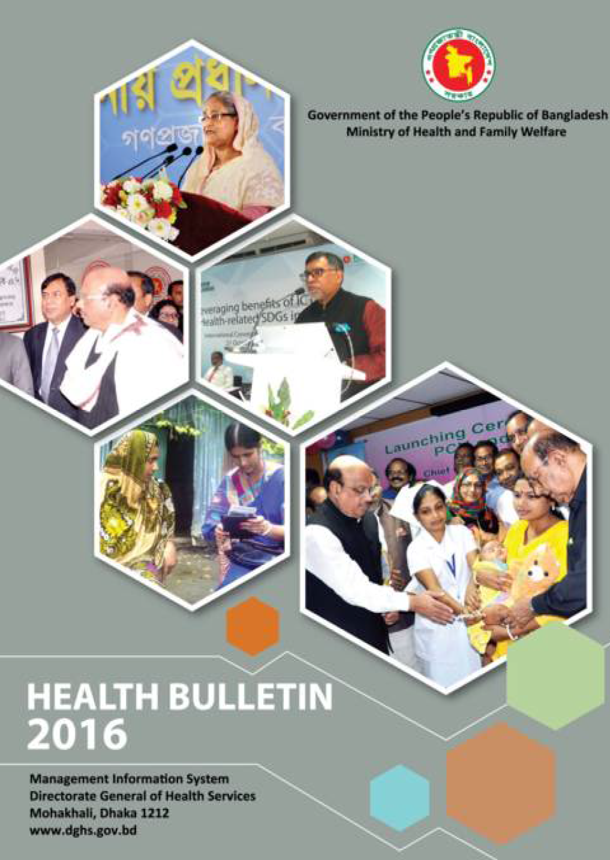
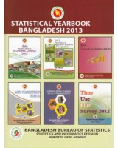
Vital Statistics
BBS
DGHS
Notes:
Two outcome documents from the Ministerial Conference:
A Ministerial Declaration to ‘Get Every One In The Picture’
A Regional Action Framework for the Decade, which contains 3 goals that you can see on the bottom right
Universal civil registration (blue icon)
All individuals are provided with legal documents to claim identity and ensuing rights (red icon)
Accurate, complete and timely vital statistics (green icon)
The Regional Action Framework have 7 areas of action, and under each of the goals a framework of targets that each country would set individually, for example by 2024, 99% of births shall be registered and 80% of deaths shall be registered.

Slide 4



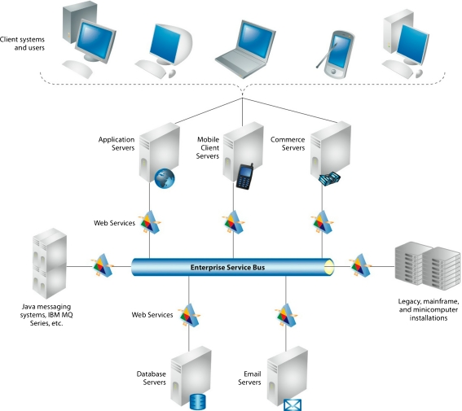

Context for systems integration
Multiple identities
Paper-based databases
No identity
NEA bus
Unconnected databases

Slide 5


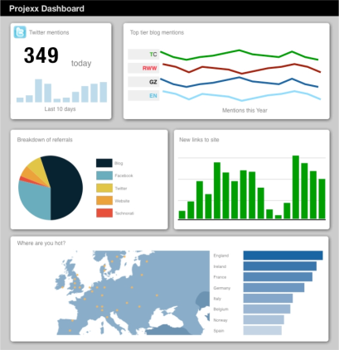


Context for systems integration
Delayed registration
Little actionable evidence for policy makers
High TCV for Service Delivery
National wastage

Slide 6
what to do?
Integration

Slide 7

The design – a simple example
1st phase
Health system notifies the birth
2nd phase
Local govt. institutions issues birth registration certificate
3rd phase
EC issues NID
A citizen is born

Slide 8

The design - solutions
3476185492
Introduction of unique ID

Slide 9
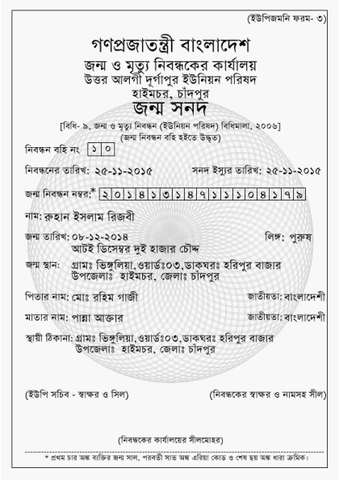

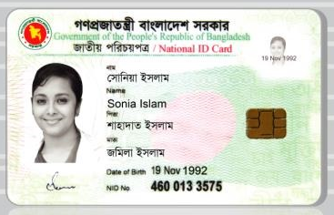
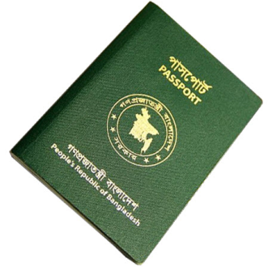
The design - solutions
3476185492
3476185492
3476185492
3476185492
National ID
Passport
Birth registration certificate
Student ID

Slide 10
The design - solutions
National ID

Slide 11

The design - solutions
3476185492
CCDS
Introduction of unique ID
Integrated databases

Slide 12


The design - solutions
Improving BDRIS
Digitizing M&DRS + CoD

Slide 13
The design - solutions
System 2
System 1
System 3
System 4
System N
System 5
System …
Integrated Systems - chaotic

Slide 14
The design - solutions
System 2
System 1
System 3
ISDP
System 4
System N
System 5
System …
Integrated Systems – with ISDP

Slide 15


The design - solutions
Single authority
3476185492
CCDS
Introduction of unique ID
Integrated databases
One source of truth
Integrated process

Slide 16
The Kaliganj model for birth and death registration and recording of CoD at the community by using VA. Four different agencies of the govt. are working for the same purposes.
EA for CRVS agencies.

Slide 17
EA- birth registration

Slide 18
EA- death registration

Slide 19

A population database
BIRTH & DEATH
NID & VOTER ID
=
ALL CITIZEN
+
MIGRATION IN
EDUCATION ENROLLMENT
HEALTH RECORD
CRVS+
CRVS database of all population of Bangladesh

Slide 20




Outcomes
A database of all population with UID and relationship structure
A set of technical standards
123456789
Convergence of all ID systems
Data visualization for policy makers and operational management
A platform connected to all registrars, service delivery agencies and statistics offices
Central authentication

Slide 21
Future !
CRVS
+
ISDP
Police services
Education
Birth registration
Health
Election
Licenses
Social safety nets
Loans
Taxes & VAT
Legal services
Labor
Immigration

Slide 22

Coordination mechanism
Steering Committee
Implementation Committee
LRC
TEC
CRVS Secretariat
PC
Policy
Functional
Thematic
ICC
=

Slide 23
SDG & CRVS
16.9 Legal identity for all
17.18 Data with disaggregation
Health
3.1: Maternal mortality
3.2: Child mortality
3.4: NCD mortality
3.8: Univ. Health Coverage
…
Education
4.1: Univ. primary & secondary edu
4.2: Pre-primary
4.4: Skills and decent jobs
…
Inequality
10.1: Accelerate income growth of the bottom 40%
10.7: Safe migration
…
Gender
5.1: Gender parity
5.3: Early marriage
5.a: Asset ownership
…
Data gap analysis
Infrastructure and Innovation
9.b: Domestic R&D
9.c: ICT-supported innovations
…
Sustainable economic growth
8.3: Job creation
8.5: Inclusive decent jobs
…

Slide 24
Thank you!

