Slide 1
CRVS in Georgia
Paata Shavishvili-Geostat
Miranda Arabidze-PSDA
Workshop for selected National CRVS Focal Points
12-14 December 2017

Slide 2
Institutional Arrangements
Public Service Development Agency
Registration of all civil acts including vital events
National Center for Disease Control
Quality check of causes of death
National Statistical Office
Collection, processing and dissemination of Vital statistics

Slide 3
CRVS system in Georgia
Geostat
Producing of VS
PSDA
Registration of vital events
Local Authorities
Non-medical births/deaths statements
NCDC
Quality check of CoD
Medical Institutions
Medical certificates including CoD
Medical Institutions
Medical certificates without CoD
Consulate
notification of vital events

Slide 4
Regulations:
Registration of birth, death, marriage and divorce :
Law of Georgia on “Civil Status Acts”
Order of the Minister of Justice #18 dated 31 January, 2012 on “Approval of the Procedures for Civil Registration“
Joint order of the Minister of Labor, Health and Social Affairs and the Minister of Justice, № 01-37/n– №173 dated 24 August 2016 on “Approval of Rules for Birth and Death Medical Forms, their Completion and Sending”
Producing of Vital statistics:
Low of Georgia on “Official Statistics”
Annual Statistical Plan

Slide 5
Completeness - Indirect Methods
 | 2013
Registered live births | 57,878
Number of population born in 2013 according to 2014 General population census | 49,693
Infant mortality | 640
Net-Migration at 0 ages | 410
Completeness rate | 115.9

Slide 6
Number of live births according to different sources and completeness rate
 | 1990-1994 | 1995-1999 | 2000-2004 | 2005-2009 | 2010-2014
Geostat - (1) | 373,442 | 265,562 | 238,760 | 263,536 | 296,143
UN - (2) | 408,134 | 311,866 | 274,525 | 303,076 | 282,324
Completeness rate (1)/(2) | 91.5 | 85.2 | 87.0 | 87.0 | 104.9

Slide 7
Causes of Deaths: Available Classifications in use
 | Year
Soviet classification 1952 (second version in 1957) | 1959-1964
Soviet classification 1952 (based on ICD-7) | 1965-1969
Soviet classification 1970 (based on ICD-8) | 1970-1981
Soviet classification 1981 (based on ICD-9) | 1981-1987
Soviet classification 1981 (revised in 1988) | 1988-1998
ICD-10 | Since 1998
Starting from 1998 Georgia causes of death are classified according to the 10th revision of the International Classification of diseases (ICD-10).

Slide 8
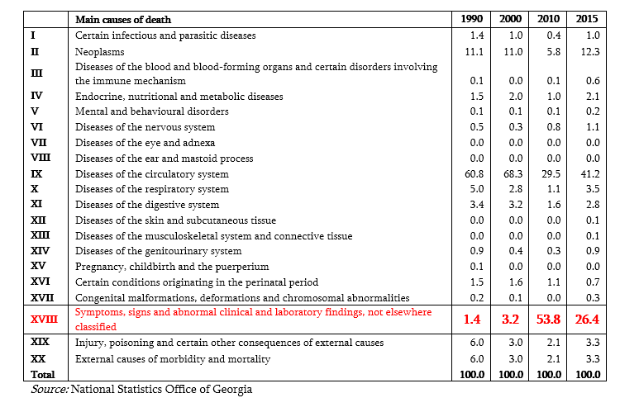
Distribution of deaths by main causes of death (%)

Slide 9
Causes of death statistics in Georgia
Medical institution is responsible for filling online medical certificate on death, including causes of death and send it to NCDC and PSDA
For death registration tasks PSDA receives information without cause of death
If death occurs outside of Medical Institution, the representative of local administration makes statement on death (which is not a medical certificate) based on the information provided by the family members (and/or other witnesses)
Geostat using dual coding (IRIS and manually) system for coding of causes of death
ANACOD program used to check the quality of data

Slide 10
Steps for improving birth and death registration
In 2017 to improve quality of birth and death registration It was introduced long and short form of medical certificate;
from 2017 NCDC (National Center for Disease Control) is responsible for collection of data through online system of birth and registration and check quality of filled medical certificates;
Link to other registers with death registration system
Adopt the system of Verbal autopsy
Adopt the institute of “Coroner” - public officer whose primary function is to investigate any death thought to be of other than natural causes.
For coverage issues-establishing Population Register

Slide 11
Dissemination of Vital Statistics
Description | periodicity | Date in Year (t)
Births Deaths Marriages Divorces | annual semi annual | March – data of Y (t-1) September – data of I-II quarter of Y(t)
Number of Population | annual | April - data of Y (t)
Net Migration | annual | April - data of Y (t-1)
Causes of death statistics | annual | June - data of Y (t-1)
Statistical Abstract “Demographic Situation in Georgia“ In Georgian and in English available on-line at Geostat’s web-page | annual | October

Slide 12
National targets of the RAF
Goal 1: Universal civil registration of vital events – achieved
Goal 2: All individuals are provided with legal documentation of civil registration of vital events – achieved
Goal 3: Accurate, complete and timely vital statistics (including on causes of death) are produced based on registration records and are disseminated – achieved, except causes of death

Slide 13
Thank you for your attention!

